Slide 1
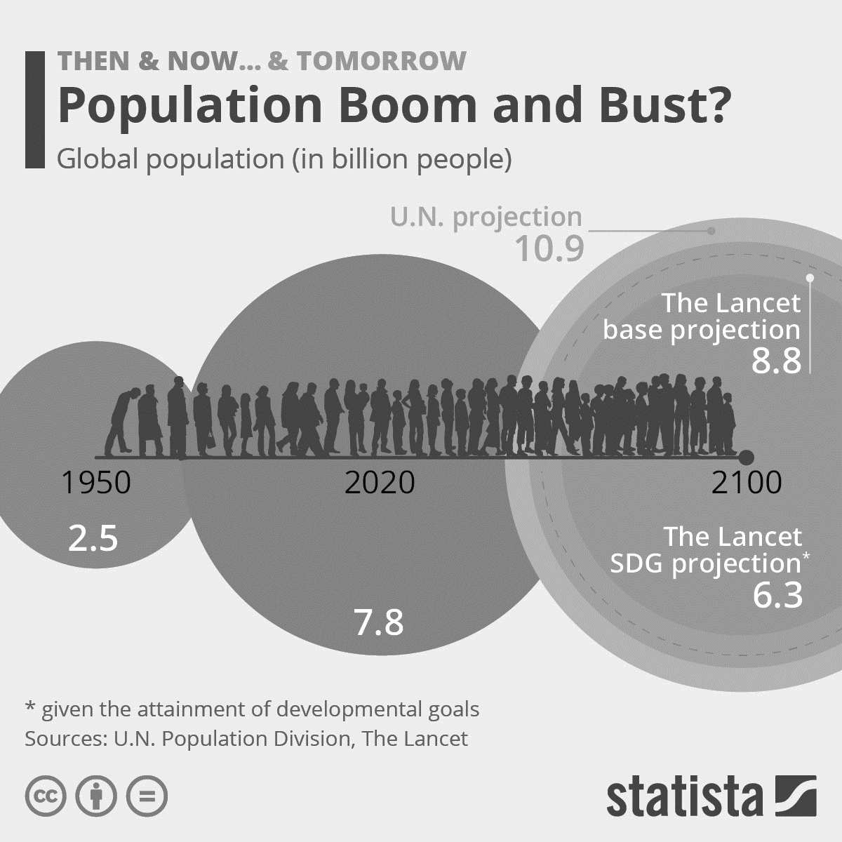
GROWTH OF WORLD POPULATION AND FUTURE PREDICTION - Group 5

Slide 2


ABOUT OUR TEAM
April Fang
Harsh Mistry
Kiran Walia
Paras Panchal

Slide 3


ABOUT OUR PROJECT
To gain a better understanding of the trends and patterns of human populations over time, what the potential implications of these changes may be, and make a future prediction to get prepared for the potential impacts of these changes.
How is the global population distributed across the world?
Which countries are most densely populated?
When and why did the world population grow?
How many people die and how many are born each year?
How does migration affect country populations?
What will be the population growth in future?
Notes:
The world population increased from 1 billion in 1800 to around 8 billion today.

Slide 4
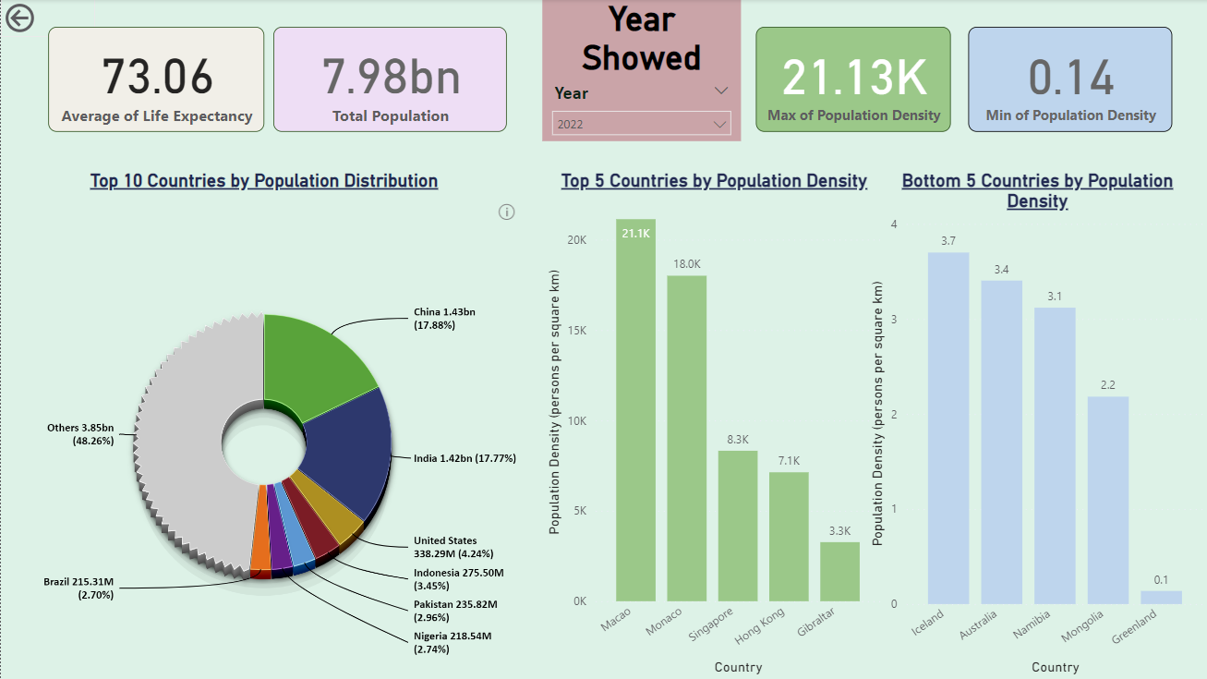
How is the global population distributed across the world?
Which countries are most densely populated?
To understand the distribution of people across the world is to reform the world density map.
Here we have top 5 countries and bottom 5 countries with population density by area.
Macao is the most populated country in terms of population density in the world according to UN data.

Slide 5
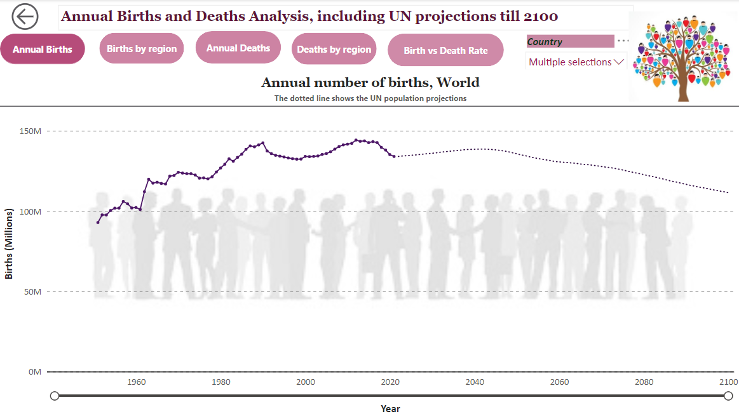
Why population growth changes?
- The main factors for growing population is birth rate and death rate.

Slide 6
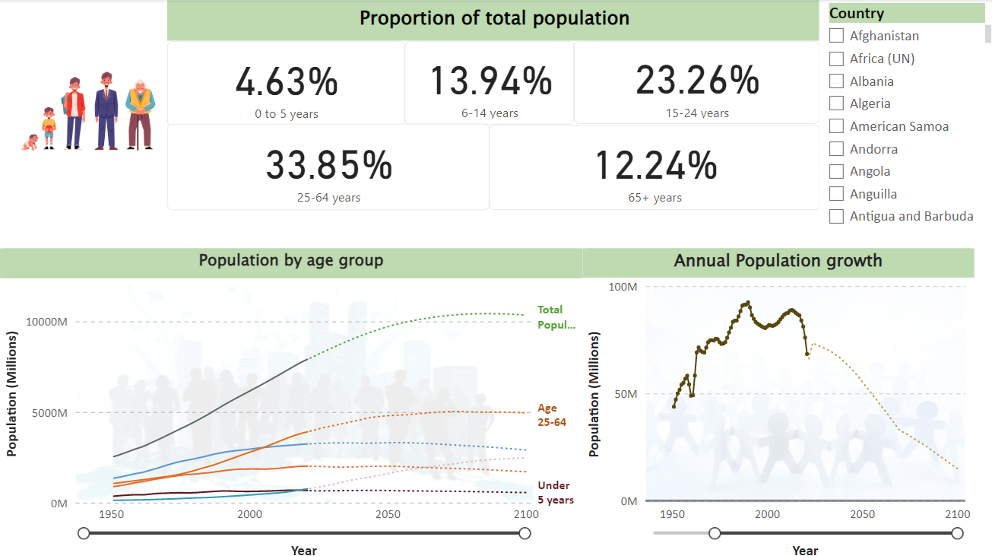
What is the proportion of total population?
Annual population was growing till 1962 and 1963 then declining over the decade.
We can see the proportion of total population by the age and from the graph we can see that at one point age of 65+ is increasing over the under the age of 5.

Slide 7
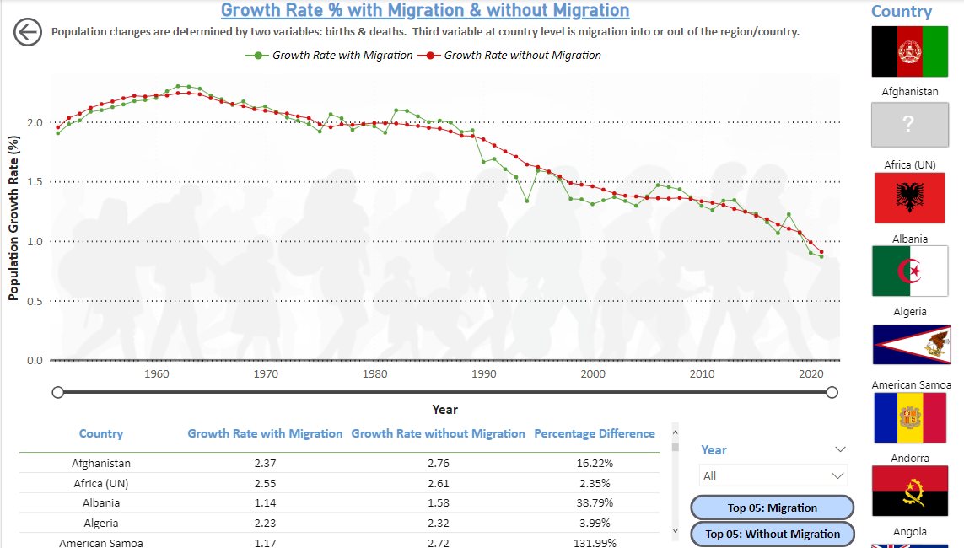
How does migration affect country populations?
As it can be seen from the above chart, Niger still had a high population growth rate despite the rate of migration.
The highest migration rate was between year 1980 to 1995

Slide 8
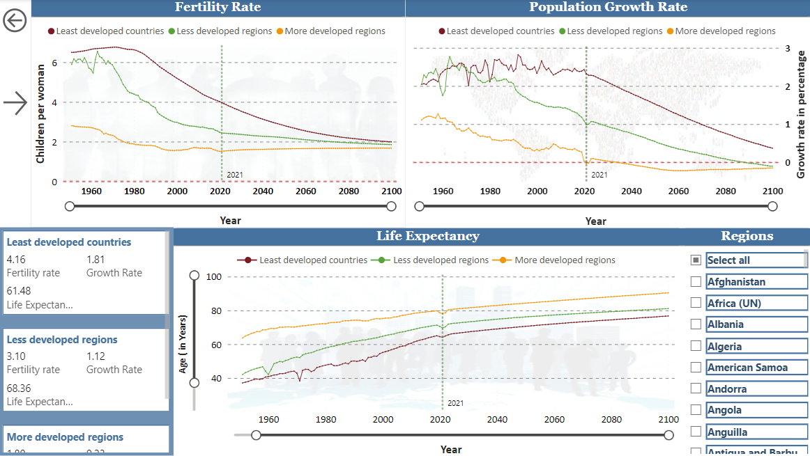
How does rapid population growth come to an end?
Life expectancy is growing year by year because of growing health sector
From the UN project prediction, life expectancy is stable in upcoming years
Fertility rate has been declining over the years and people tended to have more kids in previous years.

Slide 9
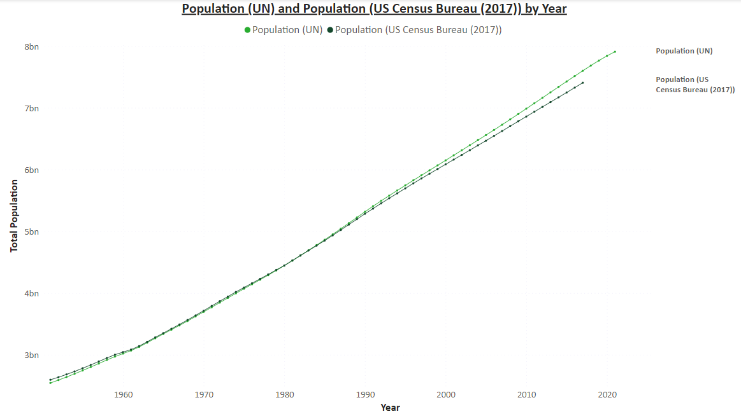
How much do population estimates differ?
Population estimates rely on various data sources, such as censuses, surveys, and administrative records. The accuracy and completeness of these sources can vary widely, depending on the quality of the data collection methods and the availability of resources.

Slide 10

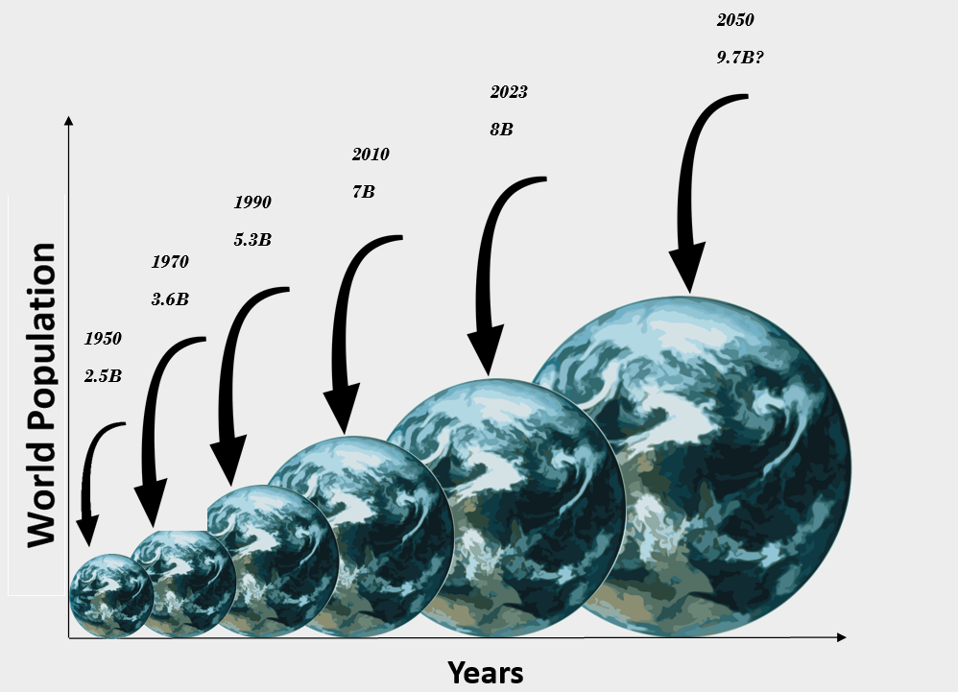
Conclusion
While population growth poses significant challenges, it also presents opportunities for innovation and progress. By implementing sustainable development policies and addressing inequalities, we can work towards a more equitable and sustainable future for all.

Slide 11

Thank you!
Any questions?

